Slide 1
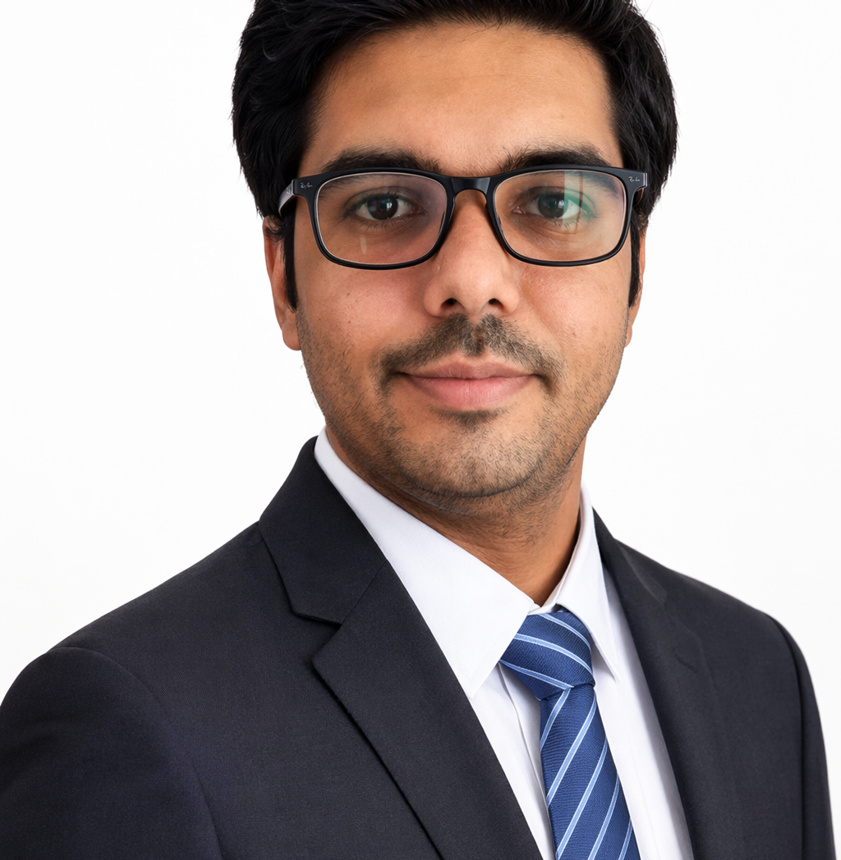
AI Advocate Test Engineering Manager/Architect
Gourav jain
EXPERIENCE (Current Org: Persistent)
Email: Jaingourav999@gmail.com
Phone: +91-9601874688
LinkedIn. Blogs. GitHub
Industrial Digital Systems Validation – Connected Asset Monitoring Platform (UHG/AEM-based System Validation)
, [May 2025 – Present]
• Led end-to-end Test / Verification & Validation (V&V) activities for enterprise-grade digital platform integrating multiple systems, ensuring reliability, performance, and scalability across components.
• Managed variety of testing activities including functional testing, integration testing, regression (repeatability), and system-level validation across UI, API, and platform layers.
• Led QA team of 8–11 engineers across manual and automation streams, ensuring effective work allocation, mentoring, and delivery tracking aligned with quality and schedule.
• Defined and implemented structured QA processes, validation strategies, and quality checkpoints across SDLC, ensuring consistent delivery standards and improved release stability.
• Designed and implemented automation frameworks using Playwright, Selenium, and Cucumber, enabling faster validation cycles and improving regression coverage.
• Developed reusable automation utilities and validation frameworks to simulate system-level testing and improve overall test efficiency.
• Managed test environments, automation infrastructure, and CI/CD pipelines (Jenkins, GitHub Actions) to ensure stable and repeatable validation cycles.
• Collaborated with cross-functional teams including development, platform, and business teams to drive common objectives on quality, cycle time, and customer satisfaction.
• Acted as primary QA interface for stakeholders and global teams, ensuring transparent communication of test progress, risks, and release readiness.
• Coordinated with external teams and vendors for resource augmentation and delivery support across testing and automation initiatives.
• Performed risk-based testing and impact analysis to prioritize validation scope and optimize testing effort for critical releases.
PROFESSIONAL BACKGROUND (TECHNICAL)
Exp: 15.5 yrs. Designation: QA Architect/Manager.
Defined QA Automation roadmap, test strategy for multiple projects.
Experience with AI tools- GitHub Copilot(certified), Testim.io, Tabnine.
Leveraged AI tools (GitHub Copilot & Tabnine) to automate 70% of test code generation, boosting productivity by 65%.
Accenture specific certifications: Certified DFA (Delivery foundation academy-4.0), PMFS (Project management foundation school), People Leadership.
Proficient in prompt engineering to optimize results in Gen AI.
Skilled in developing and customizing Test Automation frameworks, Automating test planning, authoring test artifacts, and overseeing metrics data collection.
Built robust test frameworks and can be found on GitHub.
Industries
Applied Experience
Management skill: Delivery management.
Core skill: Test Automation (Both UI and Rest/SOAP Apis)
Test automation tools: Playwright (microsoft),Selenium (4.0 Latest), Appium (V2.0-mobile app automation), Rest Assured, Postman (automation), Bruno, SOAPUI, Jest/Supertest, Pupteer, TOSCA, Cypress.
Prgramming language: java, typescript, Python
Reporting: Cucumber BDD, Serenity, Allure, XSLT, HTML
DB- AWS DynamoDB, Postgres, MongoDB, SQL Server
Build tools: Maven, Gradle. Jira, Git, Bitbucket.
Devops: Jenkins, Github actions.
Cloud: AWS (certifed developer assciate), MS Azure fundamentals(Certified), Azure DevOps, ADOBE AEM.
Banking (retail, wholesale banking, payments and mobile app)
Public domain
e-Commerce
HLS
Telecom
Salesforce/Software, SAP
SELECTED EXPERIENCE (Accenture, 9 Years)
Current project: Banking domain- Test Associate Manager (Team size: 16 QA)- BNZ (Bank of New Zealand) [Jan 2022-May 2025]
Currently Leading the 2 pods and managing end-to-end deliverables using Accenture's delivery methods for seamless execution. Led QA representation in QBR sessions for Financial Close Tribes.
Ownership of test planning, test estimation, Automation coverage, and traceability matrix, ensured that projects were delivered within the timeline, and guided testing teams in applying best practices.
Impact on project: Increase test automation coverage from 75% to ~88%. Used different tools on each pods.

Slide 2
Pod 1: Tech used: GitHub copilot, Playwright, Typescript, Java, Jenkins |Application: TFO| Domain: Wholesale banking
(UI Specific) Designed the UI automation by using Playwright with typescript.
API Integration Testing: Developed automated tests by using Rest Assured, and BDD cucumber framework for API integrations between Salesforce and external systems, ensuring data integrity and system reliability.
Pod 2: Tech used: Jest-Supertest, Typescript,Splunk, Jenkins| Application: General insurance API| Domain: Insurance
(API Specific) Worked the jest-Supertest based framework along with typescript.
Automated the API’s along with AWS DynamoDB validation and CloudWatch logs validation.
Pod 3: Tech used: Selenium, java, Rest assured, Playwright, java, Jenkins | Application: Salesforce
(Salesforce specific) Framework Development: Architected and implemented scalable test automation frameworks tailored for Salesforce applications, enhancing test efficiency and coverage.
API Automation: Led the development of API automation strategies using Rest Assured, resulting in a significant reduction in manual testing efforts.
Cross-Cloud Expertise: Managed test automation projects across multiple Salesforce clouds, ensuring seamless integration and functionality.
Playwright Automation: Done Migration from Selenium to Playwright for faster execution and automation of test cases.
Certifications/Achievements, Total exp : https://www.linkedin.com/in/jaingourav999/
Role | Org | Duration
Architect/Manager | Persistent, Pune. India | May 2025-till date.
Associate QA Manager | Accenture, Pune (India) | Oct 2015-May 2025
Senior QA (level-1) | eInfochips(Ahmedabad) | Jan 2013-Oct 2015
QA Eng. | AMD, Hyderabad | Oct 2011-Nov 2012
QA Analyst | EA Games, Hyderabad | May 2010-Oct 2011
e-Commerce domain (B2B)|Test Associate Manager in Adidas and Dyson project [April 2021-December 2021]
Enterprise application automation by using selenium with Python. API testing by Rest assured with java.
Led a team of 10 people, providing guidance and direction to achieve goals. Automated critical 316 P1 test cases out of 515 within this duration. Used Azure Devops for test cases, User stories, and Automation pipeline.
Impact on project: Understood B2B concepts. Applied more Selenium action classes to automate.
Public domain - Senior test lead in UK Govt Based project (Remove illegal immigrants) [Dec 2018- April 2021]
Impact on project: Learned AWS concepts and completed certification. Learned advanced BDD concepts.
Roles and Responsibilities
• Good knowledge of cloud technology and migrating the test code from the on-premise platform to the cloud.
• Sound knowledge of third-party tools called Saucelabs, Lamdatest.
• Creating a comprehensive test strategy and test plan that outlines the testing objectives, scope, and approach, defining test environments, test schedules, resource allocations, and test deliverables.
• Creating and providing the dashboard to clients (especially APAC and UK regions) by using Power BI and MS Excel.
• Building and leading the team of QA, assigning tasks, and managing their workloads, providing guidance and mentoring to the team members, and promoting collaborative and productive work environments.
• Estimating the testing efforts, resources, and budget required for the project.
• Establishing appropriate test metrics, and KPIs to measure the effectiveness and efficiency of the testing process.
Designed and implemented the cucumber (BDD) with testing automation framework, using selenium webdriver, TestNG, POM, Allure reporting, and docker and Kubernetes on AWS environment.
Successfully worked on the customization of the Automation framework using the concepts of cucumber-Google Guice dependency injection, JAVA 8/11.
Mainly involved in test merges, towards the complex environment and POC for supporting other vendors.
Implementing (with devops team) the CI-CD using Bitbucket, Maven, and Jenkins as part of the daily deliverables.
Managerial skills
• One of the Lead Mentors for new joiners in Accenture India DU.
• Experience in identifying and analyzing the risks and their potential business impact to determine proper prioritization of the testing activities.
• Having experience of 2 years as a scrum master. Strong experience in creating Kanban board, Metrix, dashboards in JIRA, Confluence, TFS, test case management tools, and version management software.
• Experienced QA Lead on-shore and off-shore teams, including hiring, mentoring, and performance appraisals.
• Support to manager for creating the RFP documents.
• Actively involved in CSR activities, NGO donations, women empowerment, and supporting the LGBTIQ+ community in workplaces, along with Fun activities in the team.

